Slide 1
Digital Portfolio
STUDENT NAME : VIDHYA. S
REGISTER NO AND NMID : 2422k0259 and asbru172422k0259
DEPARTMENT : BSc(computer science)
COLLEGE :Sri Vasavi College (Self finance wing)
UNIVERSITY :Bharathiyar University

Slide 2
PROJECT TITLE STUDENTS PROTFOILO

Slide 3


AGENDA
Problem Statement
Project Overview
End Users
Tools and Technologies
Portfolio design and Layout
Features and Functionality
Results and Screenshots
Conclusion
Github Link
3/21/2024 Annual Review

Slide 4

PROBLEM STATEMENT
A problem statement is a short description of an issue that needs to be solved. It clearly defines what the problem is and why it is important. The main purpose of a problem statement is to give a clear understanding of the problem before trying to find a solution. For example, in programming, a problem statement might ask us to check if a number is a palindrome.

Slide 5

PROJECT OVERVIEW :
A project overview is a short and clear summary of a project. It explains the main aim and purpose of the work. It also describes why the project is important and what problem it will solve. The overview highlights the key tasks and activities planned. It gives an idea of the methods that will be used. It also explains the expected results or outcomes. Sometimes, it includes the timeline and duration of the project. It may also mention the people involved in the work. The overview helps others quickly understand the project. Overall, it acts as an introduction and guide to the entire project.

Slide 6


WHO ARE THE END USERS?
In English, an end user is the person who ultimately uses a product, service, or system, distinct from the customer who purchases it or the technical professionals who develop or maintain it. For example, if a company buys software for its employees to use, the employees are the end users, while the company is the customer. Businesses focus on end users to ensure products are user-friendly, meet user needs, and lead to satisfaction and success in the market.

Slide 7
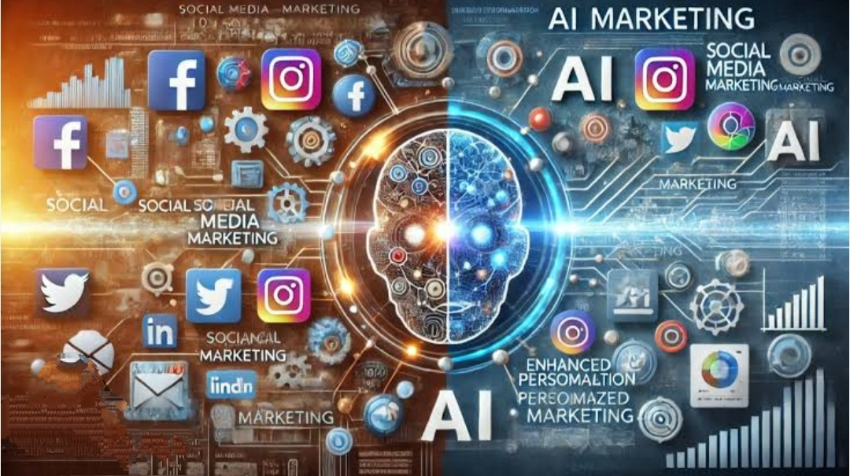
TOOLS AND TECHNIQUES
Tools and techniques are important elements used to complete any task or project successfully. Tools are the physical instruments, equipment, or software that help in doing work more easily and quickly. Techniques are the methods, skills, or approaches applied to use the tools effectively. For example, a computer is a tool, and programming is the technique to use it. In construction, machines are tools, while building methods are techniques. In project management, software is a tool, and planning methods are techniques. They reduce effort, save time, and increase accuracy in work.

Slide 8

POTFOLIO DESIGN AND
LAYOUT :
Portfolio design and layout means the way a portfolio is created and arranged. Design is about the style, colors, fonts, and images that make it look attractive. Layout is about how the information, pictures, and headings are placed on each page. A good design makes the portfolio look creative and professional. A clear layout makes it easy to read and understand. Both design and layout work together to show information in the best way. They help to highlight skills, achievements, and projects neatly.
8

Slide 9

FEATURES AND FUNCTIONALITY :
Features and Functionality means the special qualities, characteristics, and actions that a product, service, or system
Features and functionality describe what something has and what it can do.A feature is a specific quality, tool, or part of a product.It explains the design, appearance, or special elements.Functionality tells how the product works or performs tasks.It focuses on the actions and operations possible.Features attract users by showing uniqueness.Functionality satisfies users by solving problems.Together they explain usefulness and value.Good features make a product attractive.Strong functionality makes it effective and reliable.

Slide 10

RESULTS AND SCREENSHOTS
Shot screen,” a common misspelling, refers to a screenshot, which is a digital image of a device’s screen captured at a specificmoment in time. It can be used as a verb, meaning to take such an image, or a noun, referring to the resulting image itself. Screenshots areuseful for saving information, capturing errors, or sharing content from a computer or phone. “It’s” (with an apostrophe) is a contraction for “it is” or “it has,” while “its” (without an apostrophe) is the possessive form of “it,” meaning “belonging to it”. The difference is crucial: use “it’s” when you can substitute “it is” or “it has,” and use “its” when referring to something owned or associated with a thing or animal.
3/21/2024 Annual Review
10

Slide 11

CONCLUSION:
A result is the factual, raw outcome or data observed from an experiment, event, or investigation. A conclusion is the interpretation and summary of those results, explaining what they mean in the broader context and whether they support or refute an initial hypothesis. The “mean” of conclusion is its meaning, which refers to the final part or end of something or the judgment or opinion formed after considering all the information and evidence. A conclusion summarizes key points, provides a decision or resolution, and can be the culmination of a process, discussion, or piece of writing.
11

